Slide 1
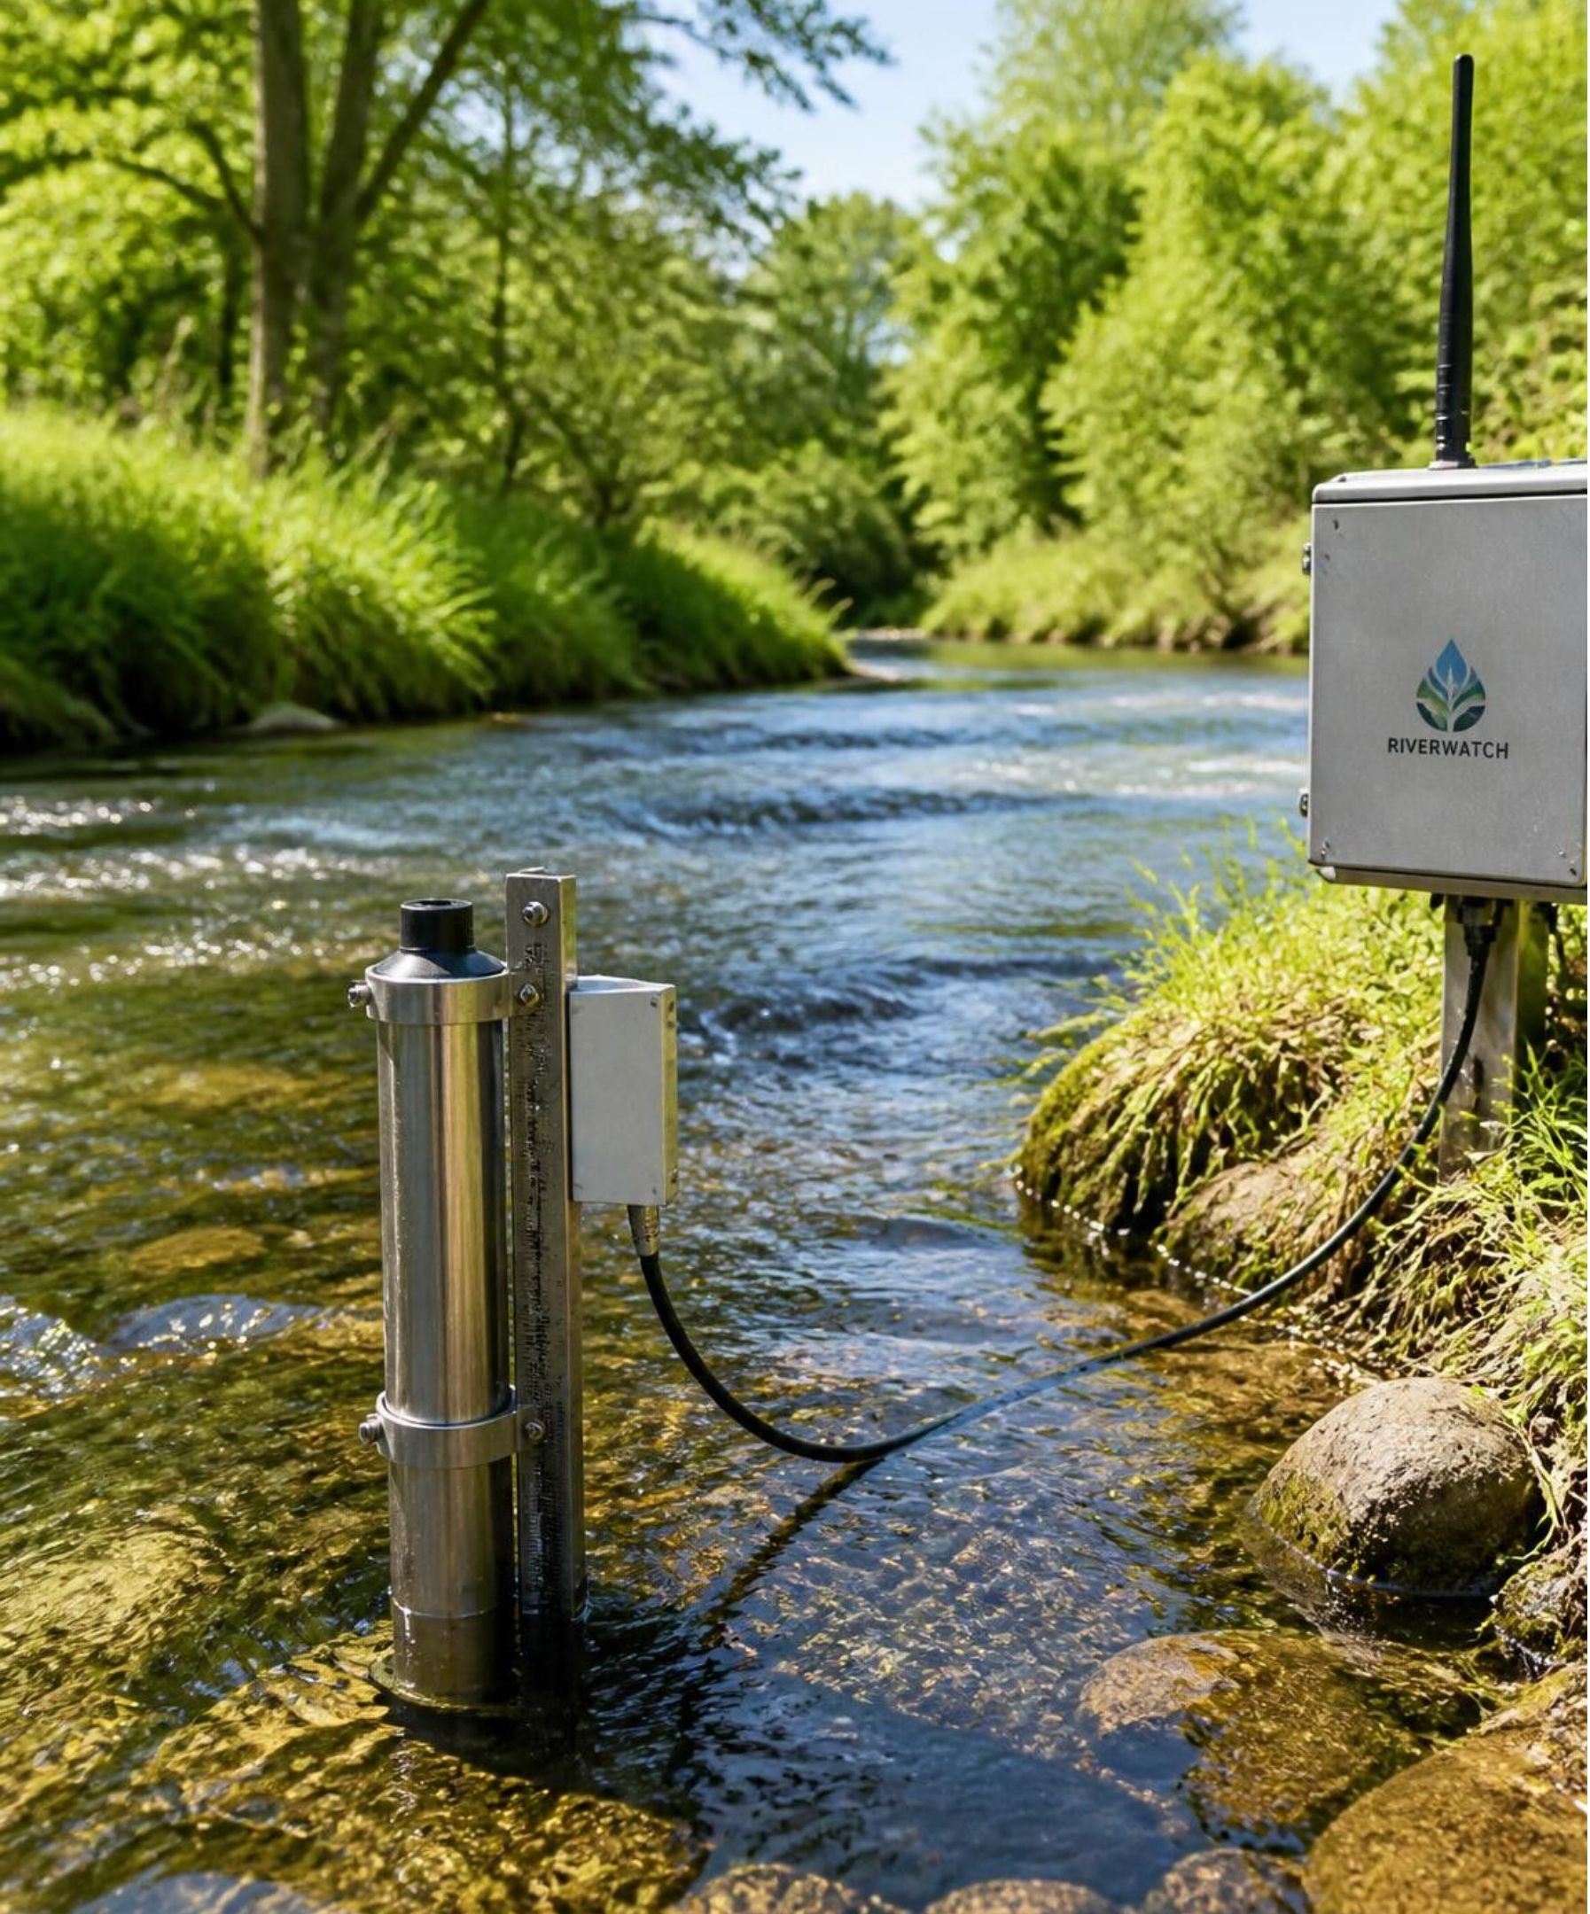
An Explainable AI-Based Decision Support System
For Dynamic Water Quality Index Prediction and Recommendation
Final-Year BTech Computer Science & Engineering Project Evaluation
Project Team
Affiliation
Chintakayala Karthikeya
Ameer Roshan Shaik
Shaik Abdul Samad
Desam Pranay Kumar Reddy
Department of Computer Science and Engineering
VIT-AP University, India
Environmental Informatics & Applied Machine Learning Laboratory
Notes:
Introduce the project title, team members, and academic affiliation at VIT-AP University.
State the core objective: building an explainable AI system that bridges water quality index prediction and concrete decision support.

Slide 2
PROBLEM MOTIVATION
Water quality is multidimensional, but decisions need one clear view
01
02
03
04
MEASUREMENT
SYNTHESIS
ML LIMITATION
INTEGRATION
Multivariate physical & chemical data
Composite index representation
Prediction without explanation
Defensible decision support
Water Quality Index (WQI) condenses multiple chemical metrics into a single standard score.
Our architecture unites predictive models, SHAP explanations, and guideline-driven action rules.
BOD, DO, nitrogen variants, and pH must be evaluated jointly rather than in isolation.
ML estimates WQI accurately, but raw scores fail to explain driver causes or downstream interventions.
Core architecture premise: prediction alone is insufficient for environmental regulation without interpretability.
2 / 10
Notes:
Explain that monitoring multiple individual chemical parameters overwhelms decision makers.
WQI solves the aggregation problem, but black-box ML models leave decision-makers without causal guidance.

Slide 3

The challenge is turning heterogeneous monitoring data into defensible action
Large heterogeneous monitoring datasets
Missing water-quality observations
Limited interpretability of ML predictions
Prediction systems that do not provide structured decision support
How can water-quality measurements become an accurate, explainable, recommendation-oriented WQI decision-support system?
3 / 10
Notes:
Detail the four distinct challenges that prevent raw telemetry from becoming policy action.
Emphasize the research question which drives the technical objectives of the project.

Slide 4

RESEARCH CONTEXT & CONTRIBUTION
The gap is integration, not invention
Component | Role
Traditional WQI approaches | Construct composite indices.
ML-based prediction | Estimates WQI from measurements.
Deep learning | Broadens the model comparison.
Explainable AI | Attributes predictions to features.
Recommendation systems | Translate analysis into possible actions.
Gap | These elements are not necessarily integrated into one reproducible workflow.
Contribution: integrated workflow and experimental evaluation, not a new WQI, CatBoost, XGBoost, or SHAP algorithm.
4 / 10
Notes:
Be explicit about the project's intellectual boundaries: we do not invent a new ML algorithm or index formula.
The academic value lies in integrating data cleaning, WQI calculation, comparative modeling, SHAP explainability, and rule-based recommendations into a single pipeline.

Slide 5
RESEARCH METHODOLOGY
Six objectives connect data preparation to decision support
01
02
03
Dataset preparation
WQI construction and prediction
ML versus DL comparison
04
05
06
Model evaluation
Explainability using SHAP
Decision support and recommendation
5 / 10
Notes:
Walk through the six sequential phases of the research.
Notice how each objective feeds cleanly into the next, culminating in practical decision support.

Slide 6
EXPERIMENTAL DATASET
One long-term dataset supports the full experiment
Dataset detail | Value
Period | 1990–2024
Raw observations | 178,680
Variables | 40
Monitoring stations | 1,311
WQI parameters
BOD, Ammonia-N, Nitrite-N, Nitrate-N, pH.
ML/DL features
BOD, DO, Ammonia-N, Nitrite-N, Nitrate-N, pH.
DO predicts WQI but is not used to construct it.
Source: Northern Ireland Environment Agency (NIEA)
6 / 10
Notes:
Present the long-term dataset scale and distinguish WQI construction parameters from ML/DL features. DO predicts WQI but is not used to construct it.

Slide 7
DATA PREPARATION
Missing values were handled by parameter-specific methods
01
02
03
04
05
06
Raw data
Inspection and missing-value analysis
Quality control
Parameter-specific imputation
Station-year aggregation
WQI dataset
Predictive Random Forest
Station-based temporal
DO
BOD, Ammonia-N, Nitrite-N
Nitrate-N, pH
Not imputed
Outcome: 10,178 missing measurements were recovered. The project did not blindly fill every missing value.
7 / 10
Notes:
Describe the 6-stage preprocessing sequence.
Explain why parameters were divided: BOD/Ammonia/Nitrite benefited from RF, Nitrate/pH from temporal continuity, and DO was deliberately left unimputed.
State the exact count: 10,178 recovered values.

Slide 8
EMPIRICAL VALIDATION
Validation selected the imputation method per parameter
Compare predictive and temporal validation using the exact project results; temporal validation has no available R² value.
Parameter | Predictive MAE | Predictive RMSE | Predictive R² | Temporal MAE | Temporal RMSE | Selected
BOD | 0.6808 | 2.3218 | 0.4438 | 0.9840 | 4.4578 | Predictive
Ammonia-N | 0.0653 | 0.3055 | 0.3459 | 0.0913 | 0.4867 | Predictive
Nitrite-N | 0.0078 | 0.0206 | 0.5338 | 0.0092 | 0.0248 | Predictive
Nitrate-N | 0.5863 | 0.8742 | 0.5064 | 0.3651 | 0.6394 | Temporal
pH | 0.2562 | 0.3508 | 0.2777 | 0.2120 | 0.2960 | Temporal
8 / 10
Notes:
Present the exact experimental validation table.
Highlight that Predictive RF wins for BOD, Ammonia-N, and Nitrite-N with lower MAE and RMSE.
Note that Temporal interpolation wins for Nitrate-N (MAE 0.3651 vs 0.5863) and pH (MAE 0.2120 vs 0.2562).

Slide 9
INDEX FORMULATION
CCME-WQI turns guideline performance into a constructed target
The Canadian Council of Ministers of the Environment Water Quality Index synthesizes compliance across three mathematical dimensions:
F1
F2
F3
Scope
Frequency
Amplitude
Percentage of parameters that do not meet guidelines at least once during the monitoring period.
Percentage of individual test tests/measurements that violate environmental guidelines.
Amount by which failed test values exceed guidelines, normalized via normalized sum of excursions.
95–100 · Excellent
80–94 · Good
65–79 · Fair
45–64 · Marginal
0–44 · Poor
Critical methodological premise: WQI is a constructed target metric derived from regulatory compliance, not an unmediated physical quantity.
9 / 10
Notes:
Present the standard CCME-WQI mathematical formulation and its three factors: Scope (F1), Frequency (F2), and Amplitude (F3).
Emphasize that WQI is a calculated index of regulatory compliance, which our ML models learn to approximate.

Slide 10
END-TO-END ARCHITECTURE
The proposed system moves from measurements to a recommendation-ready dashboard
PREDICTION
EXPLANATION
DECISION SUPPORT
NIEA data
Data preprocessing
Missing-value handling
Station-year aggregation
CCME-WQI construction
ML + DL models
Model evaluation
CatBoost
SHAP explainability
Guideline analysis
Recommendation engine
Streamlit dashboard
PREDICTION → EXPLANATION → DECISION SUPPORT
10 / 10
Notes:
Summarize the complete 12-step engineering architecture.
Reiterate the central spine: Prediction (CatBoost) -> Explanation (SHAP) -> Decision Support (Streamlit Dashboard & Rules).

